Slide 1
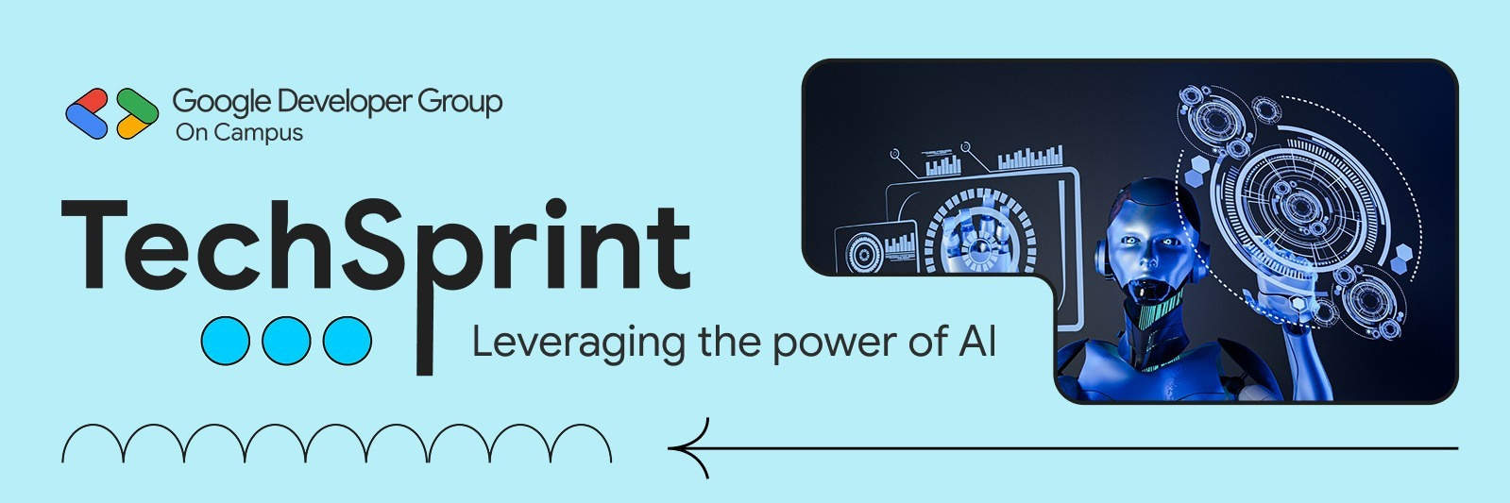

h
TEAM:- ZODZY
AI PARASITIC SOCIAL MEDIA GROWTH INFRASTRUCTURE
Lead: B Kathikeyan
Members: Kavin Prakash K, S Sruthi

Slide 2

Problem Statement (PS)
• Content creators and digital businesses struggle to keep up with the immense manual effort needed to analyze their YouTube performance, manage emails, and respond to opportunities.
• Without an automated system, they waste valuable time on repetitive tasks, miss critical insights, and lose growth opportunities.
• Our solution addresses this by providing a fully automated AI infrastructure that handles analytics, email management, proposal generation, and more, allowing creators to focus on what they do best

Slide 3

Solution & Uniqueness
Proposed Solution
An admin controlled AI automation platform powered by 16 autonomous AI agents that analyze performance data and execute growth actions end-to-end without manual intervention.
‑
Key Capabilities
Data → decision → action (fully automated)
Task-driven AI agents for growth, communication, and monitoring
Uniqueness
Agentic AI Dashboard with clear, task-based workflows
Zero human dependency for promotions, leads, or proposals
AI agents independently handle outreach, proposals, bookings, and follow-ups

Slide 4
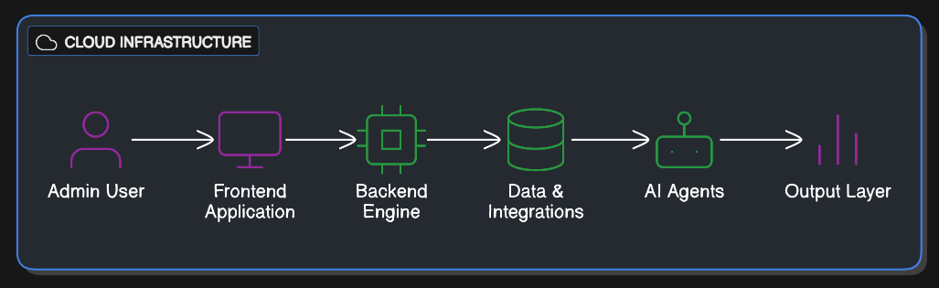
Architecture & Workflow
System Architecture

Slide 5
Automations We Made
Data & Performance Automations
• YouTube Information Collector
• Like Scraper
• Duration Scraper
• Favorite Scraper
• Title Scraper
• Published At Scraper
• Tags Scraper
• Comments Scraper
AI Agents & Workflow Automations
• Gmail Categorization Agent
• Proposal Agent
• Booking & Appointment Chatbot
• Script Writing Agent
• Personalized Chatbot
• 24+T Performance Monitoring Agent
• Template Generation Agent
• Lead Generation Agent

Slide 6
Tech Stack & Google Tools
Technology Stack
Google Sheets:
For organizing and analyzing YouTube data.
Google Slides:For generating automatedreportsand proposals.
Google Gemini: For advanced natural language processing and content insights.
Google Gmail: For automating email communications and categorization. Google Calendar: For scheduling and managing bookings and appointments automatically. Google Drive: For securely storing and sharing documents generated by the AI agents. Google docs: for storing the data to the RAG Agent Google AI Studio: for an orchestration dashboard to aggregate all agents

Slide 7
Feasibility, Viability & Scalability
Feasibility & Viability
This project is highly feasible due to its use of reliable Google tools like Google Sheets, Slides, Gmail, and Calendar, integrated with AI models and an orchestration dashboard.
The solution is highly viable as it addresses a real-world need by automating repetitive tasks for content creators, saving them significant time and effort.
The project is designed to scale easily, as the combination of 16 AI agents and the
orchestration dashboard can handle increasing volumes of data and more complex
workflows without compromising performance.

Slide 8
Impact & Future Scope
Impact: We turn creators’ biggest pain points into automated solutions, letting them boost their content quality and make more money with less effort. It’s a win for the whole social media community and for their business growth.
TargetUsers:Content creators and social media managers who want
to save time and focus on creativity..
Future Scope: We’ll keep expanding with :-
AI Calling VoiceAssistant
AI Video Generation with NLP

Slide 9
Optional Links (If Available)
GitHub Repository:
https://github.com/Kavin-Prakash7/zodzy-ai-social-growth-infra
Demo Video Link:
https://drive.google.com/f ile/d/12owyDDlDlZQg3wHIxwuSjU2y1-NUnHs0/view? usp=sharing
MVP / JSON / Architecture Files: Available in GitHub repository

Slide 10
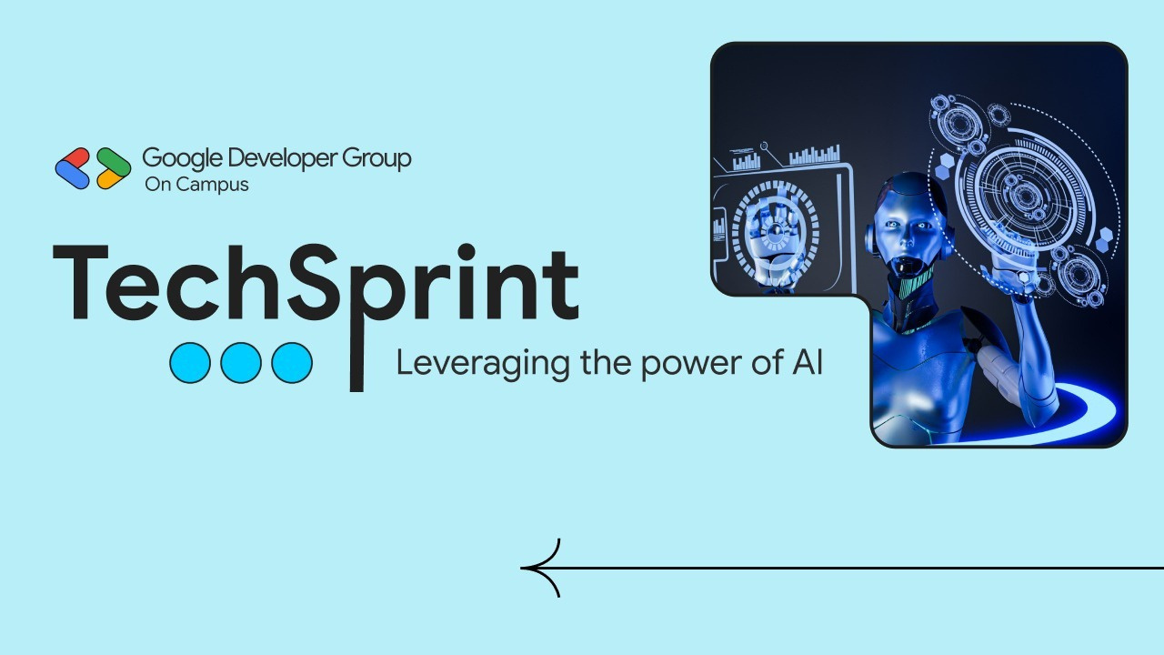
Thank you!

